Slide 1
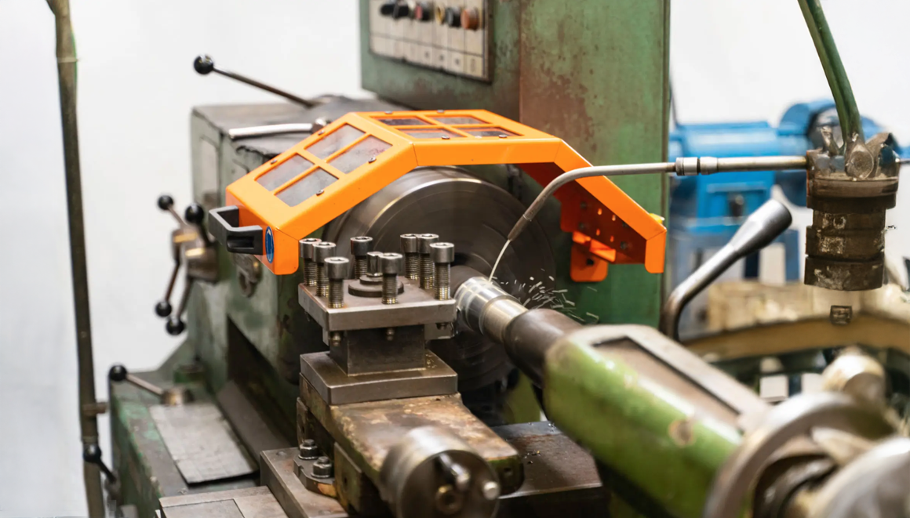
Toolbox
Machine safety: Lathe
Company name and date

Slide 2

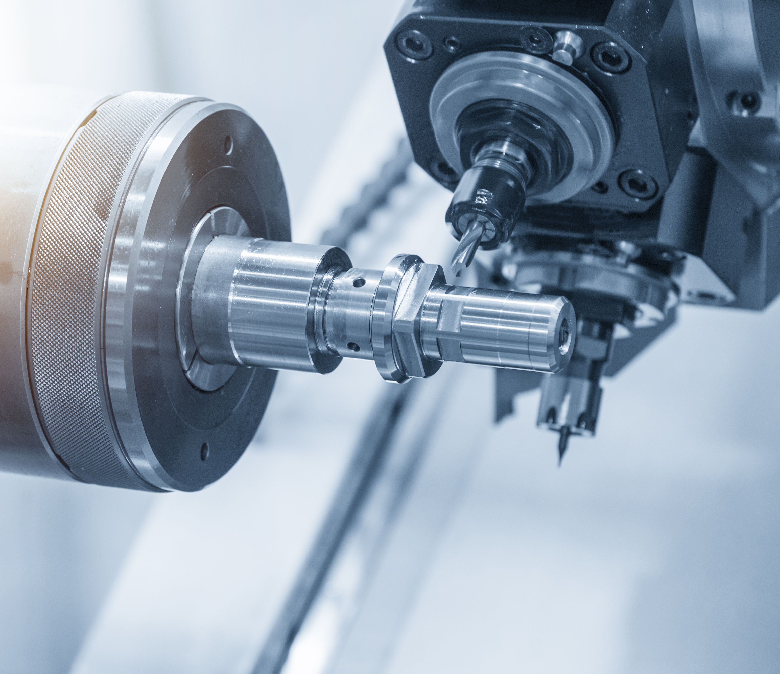
Contents
Safe and healthy working practices | Machine safety: Lathe
Why machine safety?
Top 3 accidents
Safe machine
What can you do yourself?

Slide 3
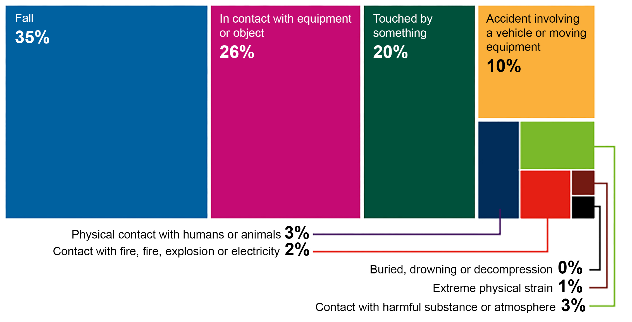
Safe and healthy working practices | Machine safety: Lathe
Why machine safety?
Accident investigations completed in 2023, broken down by accident type.
Large proportion of the number of reported occupational accidents.
Contact with work equipment or object 26%.
Source: Work Accident Monitor 2023 – Dutch Labour Inspectorate
Notes:
https://www.nlarbeidsinspectie.nl/publicaties/rapporten/2024/08/26/monitor-arbeidsongevallen-2023
The accident type "Contact with work equipment or object" is common in the Industrial sector (42% of accidents in that sector). The majority of accidents involve accidents in which the victim came into contact with moving parts of a machine (69%).

Slide 4
Guard missing
Safe and healthy working practices | Machine safety: Lathe
Why machine safety?
Cause of contact with moving parts:
Guard missing, but insufficiently effective
Guard removed
Incorrect operation

Slide 5
Contact between fingers/hands and moving parts.
Safe and healthy working practices | Machine safety: Lathe
Lathe accidents: top 3
Polishing/sanding with a lathe.
Product not properly clamped (thrown out of the lathe)
Serious and permanent injury:
Amputation and fractures of fingers, hands, arms or internal injuries.
Fractures and large cuts to other parts of the body resulting in loss of function.

Slide 6
Check whether the chuck is protected by a guard (engaged).
Safe and healthy working practices | Machine safety: Lathe
Safe machine
Check whether the emergency stop is immediately accessible during use.
Check whether the power cables, plugs and connections are undamaged.
Check whether the rear is protected.
Advice:
Shielding take-off shaft
Claw wrench with spring

Slide 7


Safe and healthy working practices | Machine safety: Lathe
What can you do yourself?
Sanding, polishing and deburring products is only permitted when the lathe is stationary.
Do not wear gloves.
Always wear safety goggles.
Never remove chips by hand when the machine is running; use tools specifically designed for this purpose.
Prevent clothing, jewellery and hair from getting caught in the lathe.
Test the emergency stop.
Ensure your workplace is tidy and free of shavings and cooling lubricants.

Slide 8
Safe and healthy working practices | Machine safety: Lathe
What can you do yourself?
Never bypass safety devices.
If safety devices are missing or have been bypassed, discuss this with your manager.
Do not start work if you have any doubts about the safety of the machine; discuss this with your manager.

Slide 9

Safe and healthy working practices | Machine safety: Lathe
Questions?
info@5xbeter.nl | www.5xbeter.nl

Slide 10
Safe and healthy working practices | Machine safety: Lathe
Need help?
Discuss it with your manager or contact the health and safety officer.
Consult an Improvement Coach from 5xbeter: www.5xbeter.nl
Or call the FREE Improvement Line: 0800 – 55 55 005
info@5xbeter.nl | www.5xbeter.nl

